Slide 1
MICROSOFT AZURE
Introduction by Shubhechchha, Jakub and Hans

Slide 2

INTRODUCTION TO MICROSOFT AZURE
Recommending movies to users using sample dataset

Slide 3
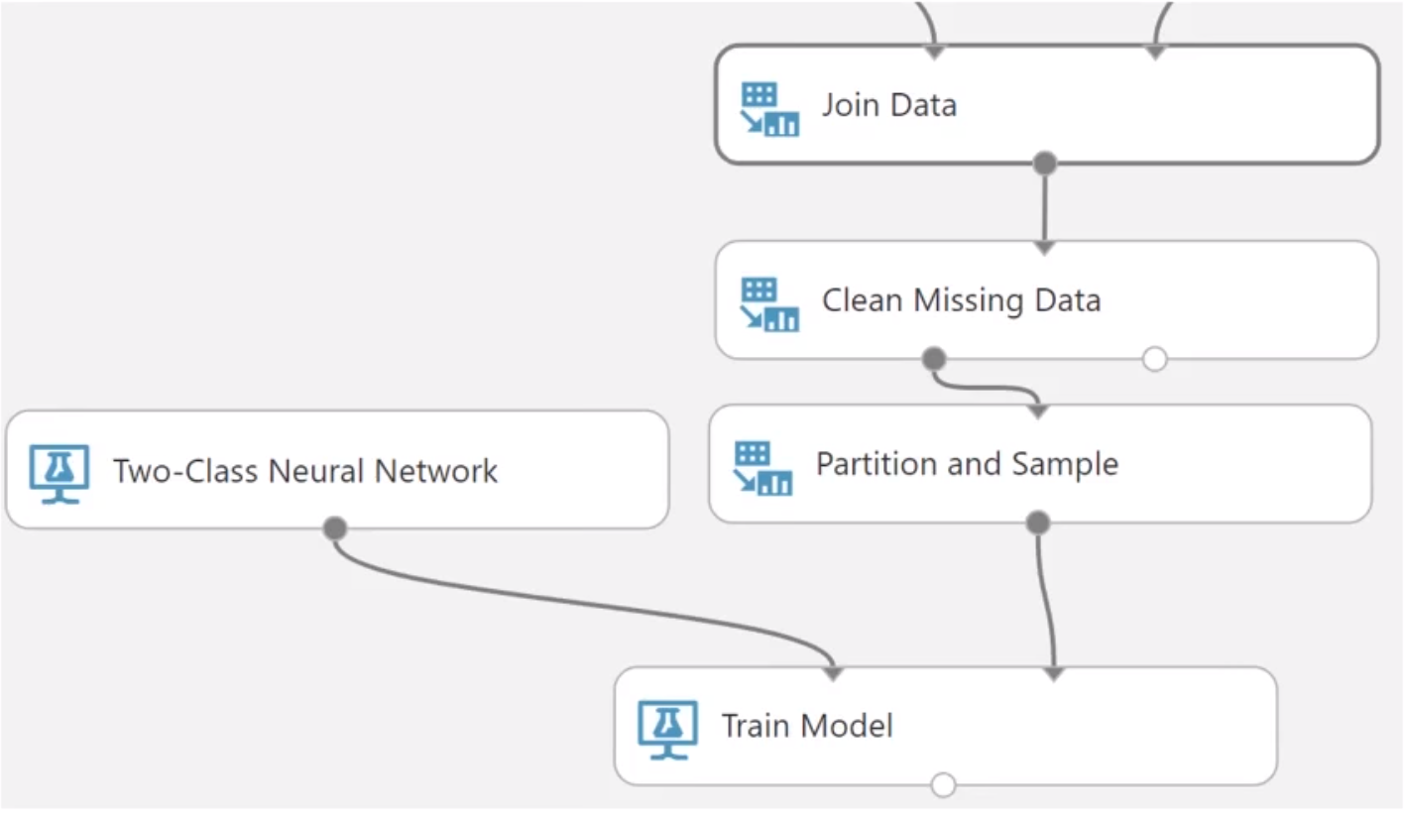
MICROSOFT AZURE LEARNING STUDIO
Interactive virtual workspace.
Build, test and iterate data on a
predictive analysis model.

Slide 4
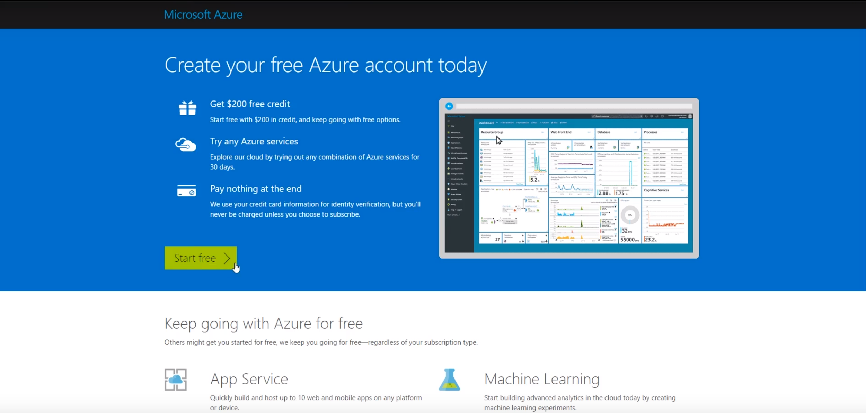
ACCOUNT

Slide 5
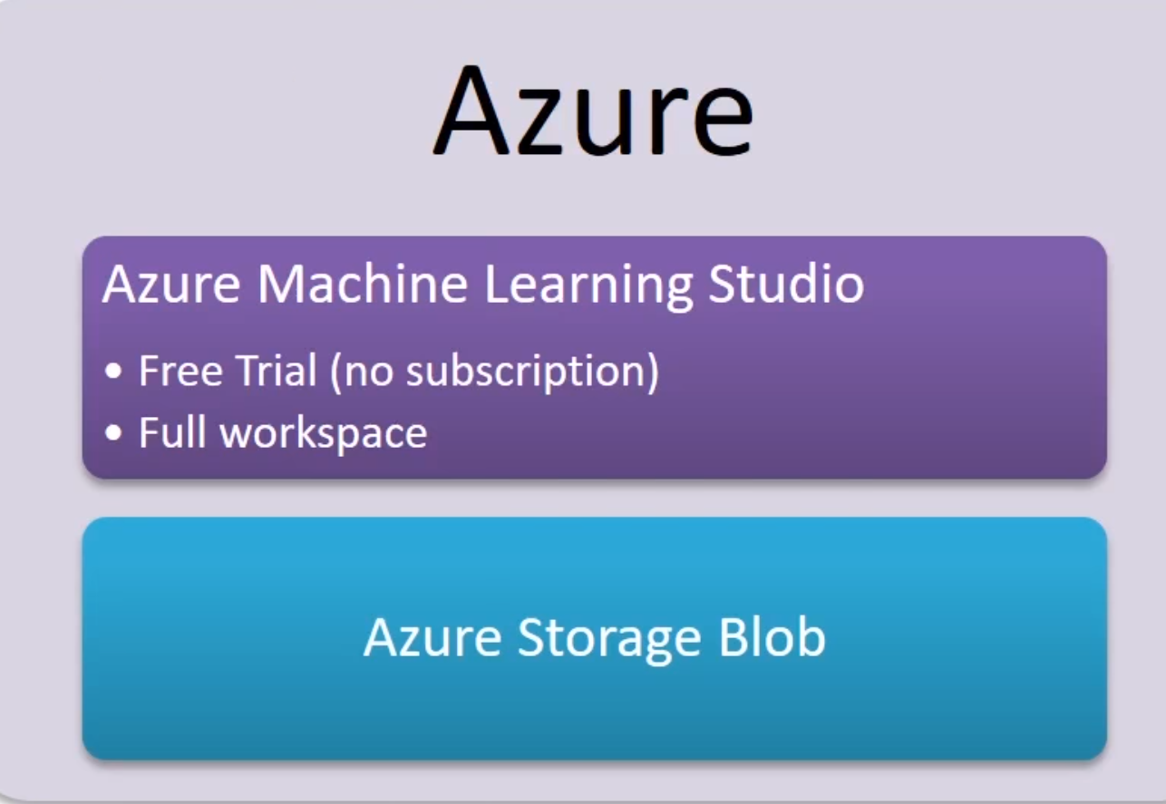
SUBSCRIPTION
One month free trial - $200 Azure credit. (does not require Azure)
Full Workspace (requires Azure)

Slide 6
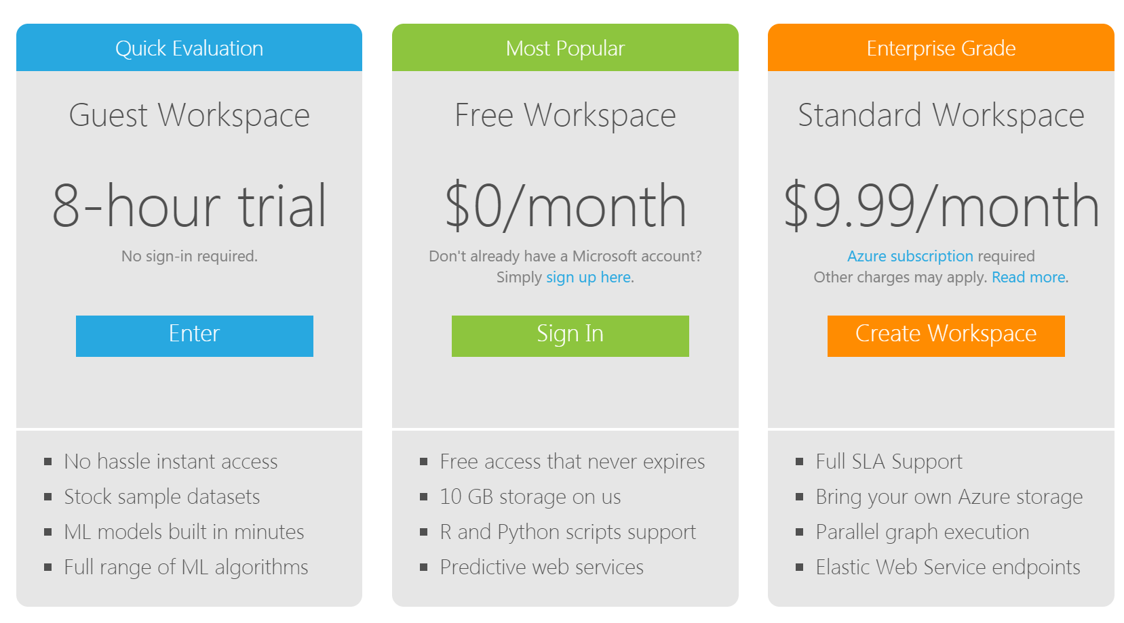

Slide 7
RECOMMENDER SYSTEM
Recommending movies to users using sample dataset

Slide 8
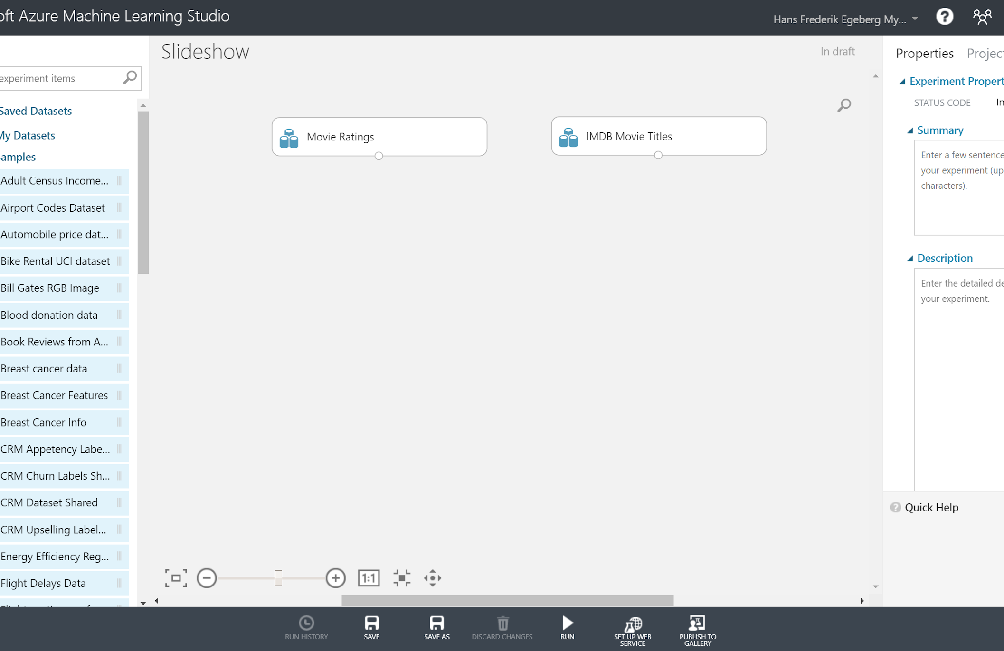
DATASET
Movie Ratings
IMDB Movie Titles
Both are found in Sample datasets

Slide 9
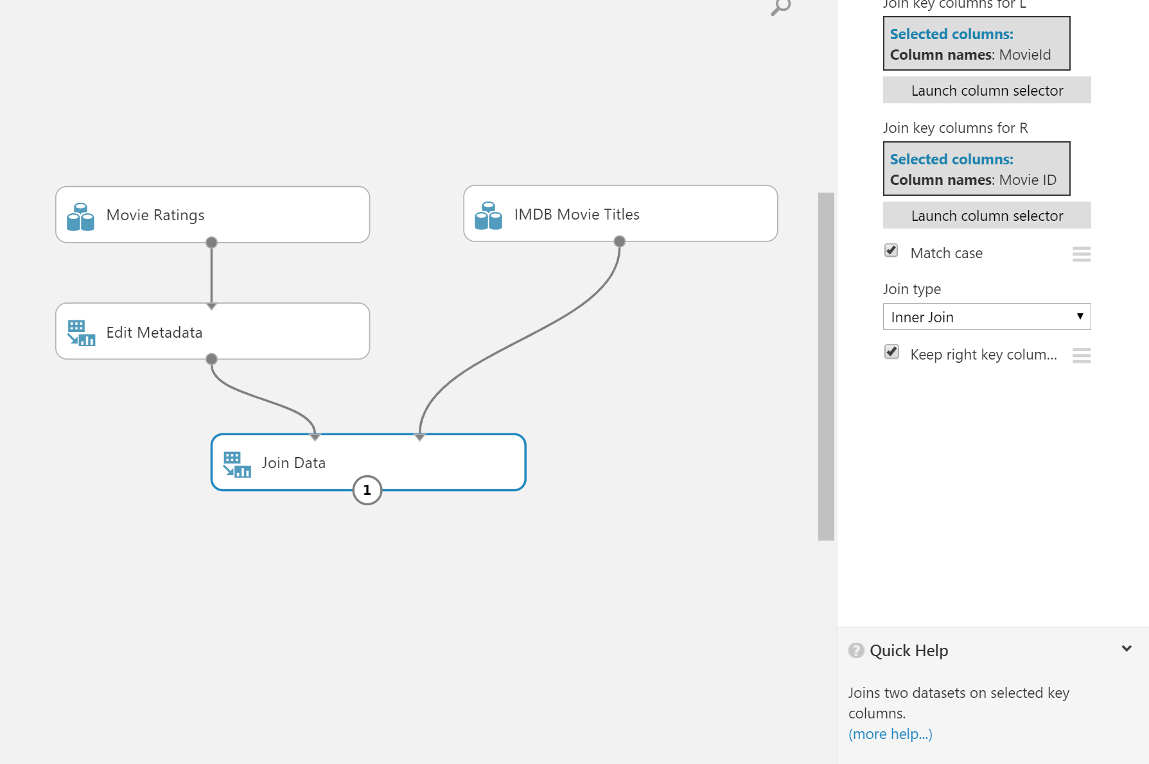
DATA PREPARATION & JOIN
Edit Metadata
Rating has to be of INT
Use “Edit Metadata”
Set “Data Type” to INT
Join Data
Join datasets by Movie ID

Slide 10
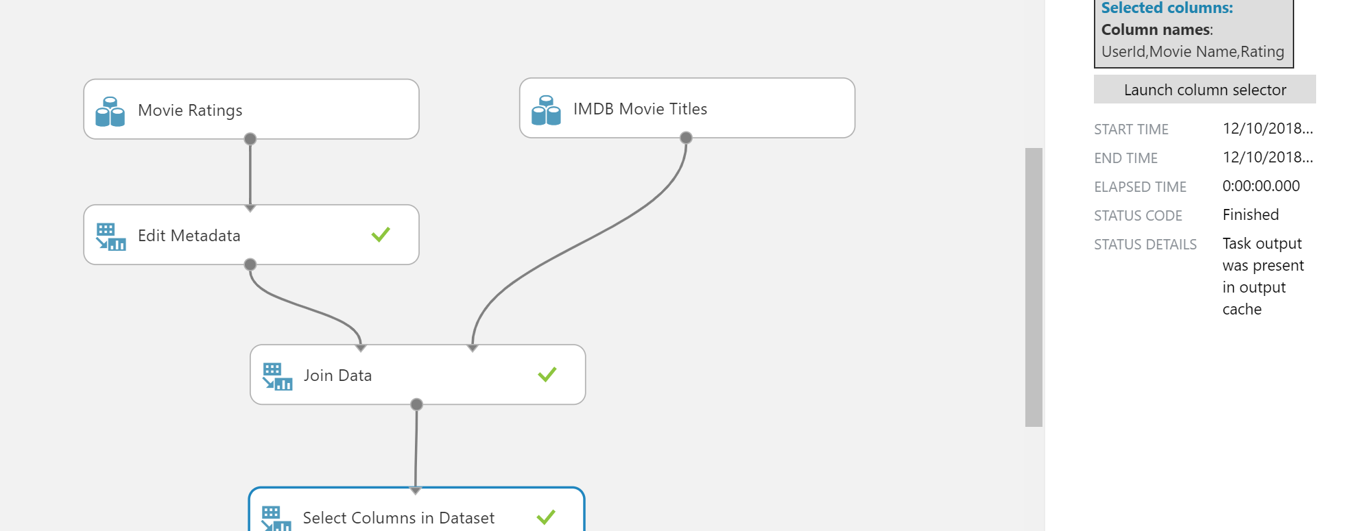
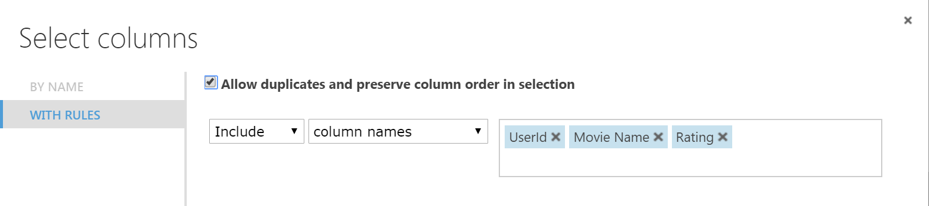
SELECTING COLUMNS
Insert “Select Columns in Dataset”
We want to see “UserId”, “Movie Name” & “Rating”
The rating has to be the last parameter. It is therefore important to enable “Allow duplicates and preserve column order in selection” & rating as the last parameter

Slide 11
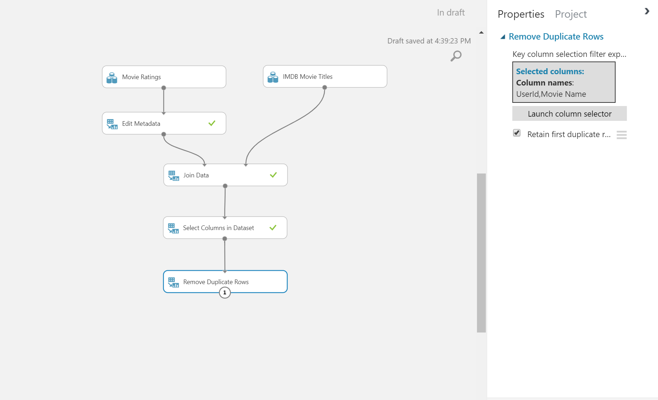
REMOVING DUPLICATES
We clean duplicates by using the “Remove Duplicate Rows”
Enter “UserId” & “Movie Name” as the parameters

Slide 12
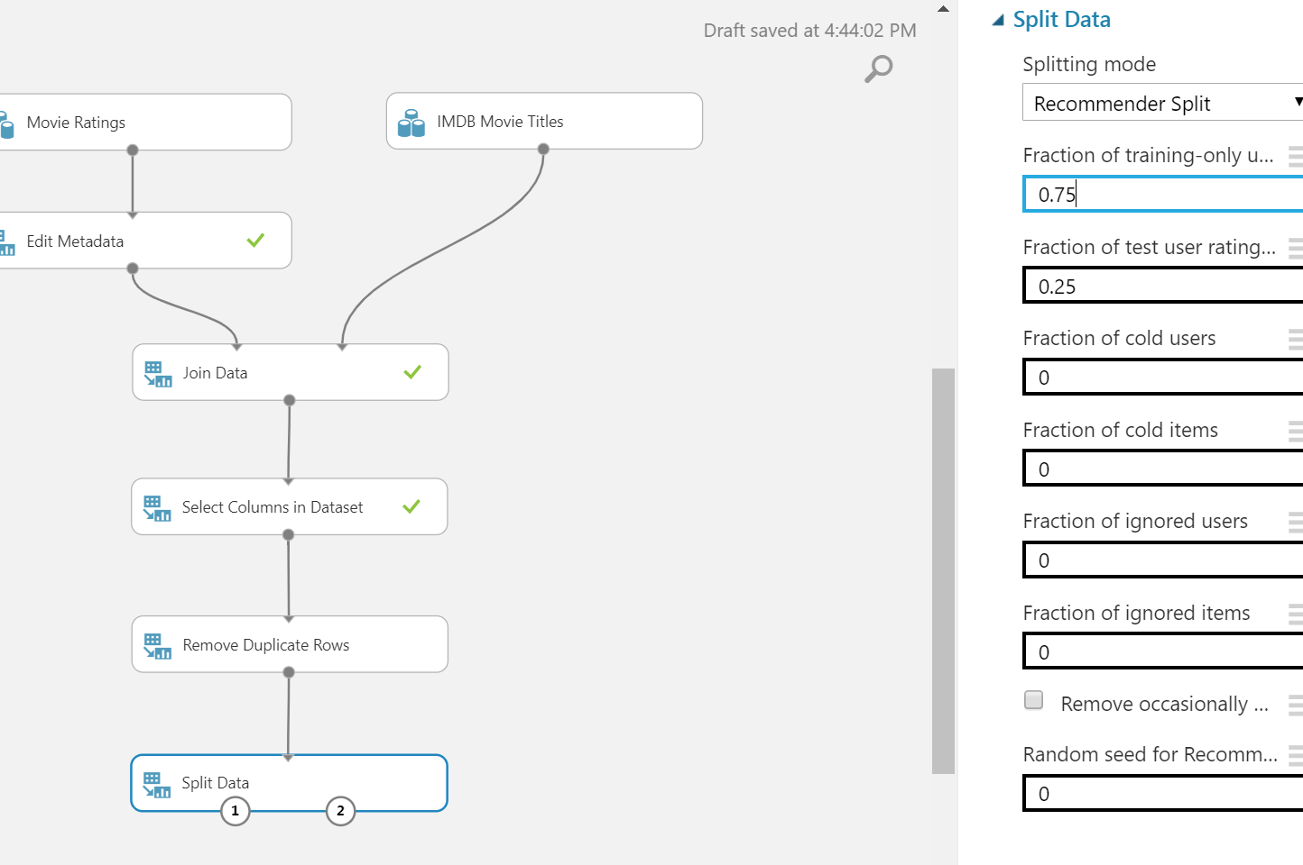
SPLITTING DATA
Insert “Split Data”
Set splitting mode to “Recommender Split”
Fraction of Training Only users is the amount of users only used for training. We set this to 0.75
Many tweaks can be set here if needed.
Left port (1): Training Data Right port (2): Test Data

Slide 13
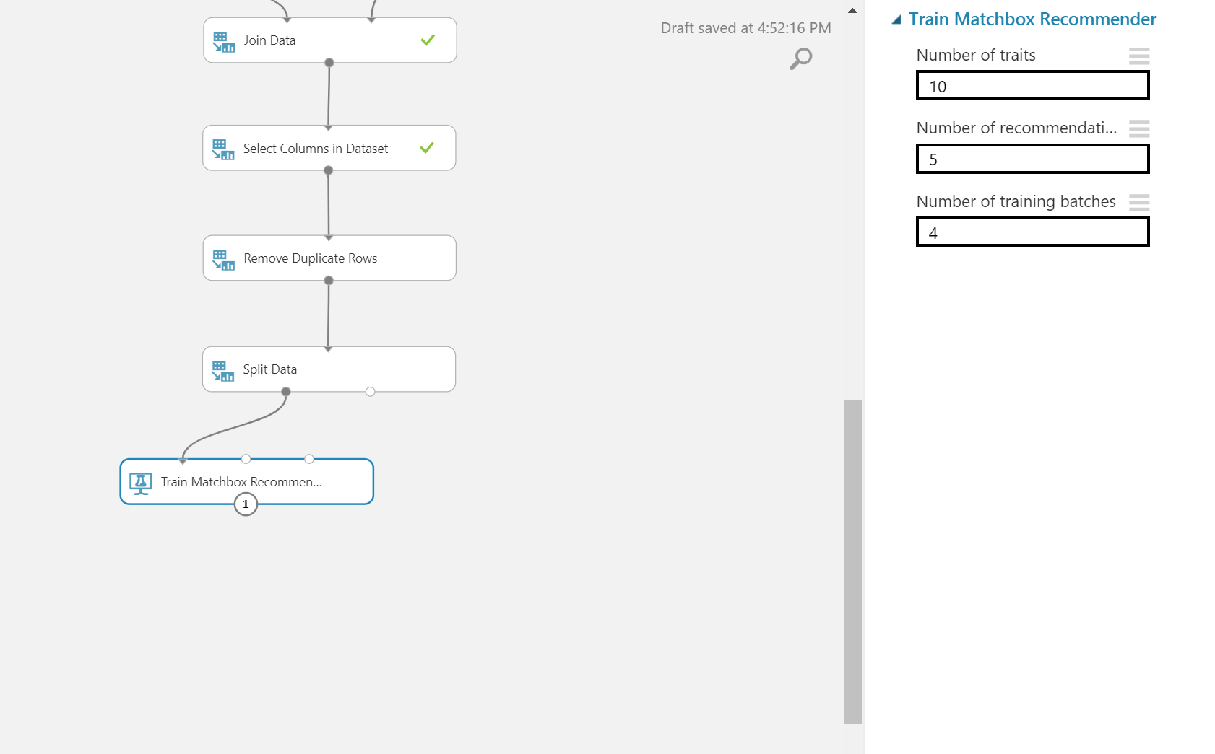
TRAIN MODEL
Insert “Train Matchbox Recommender”
Many tweaks can be set here if needed such as the number of recommendations or iterations.
More info: Documentation

Slide 14
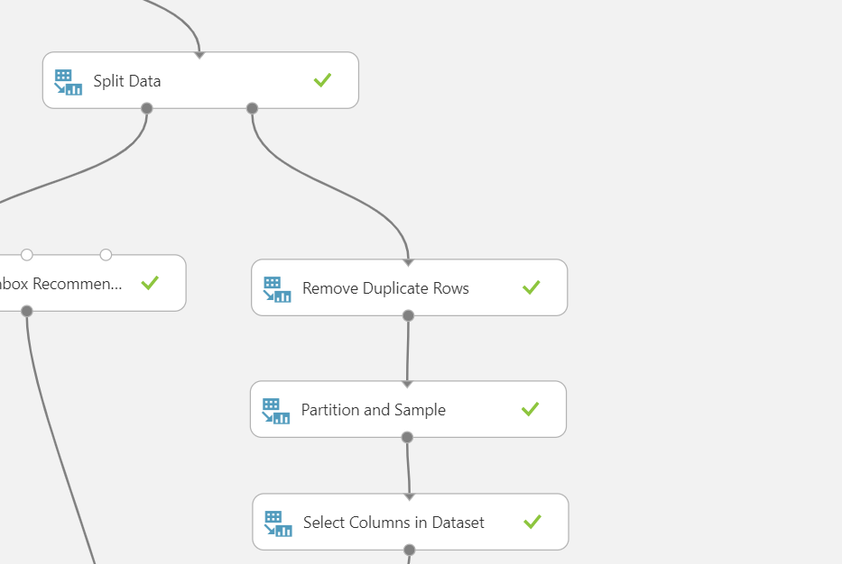
ISOLATING USERS & PARTITIONING
Insert “Remove Duplicate Rows”
We just need the unique users, so we remove the multiple duplicates from the test data.
Insert “Partition and Sample”
Set mode to “Head”
Set value to 100-500 rows
Insert “Select Columns in Dataset”
Select the column “UserId” in the “Select Columns in Dataset”

Slide 15
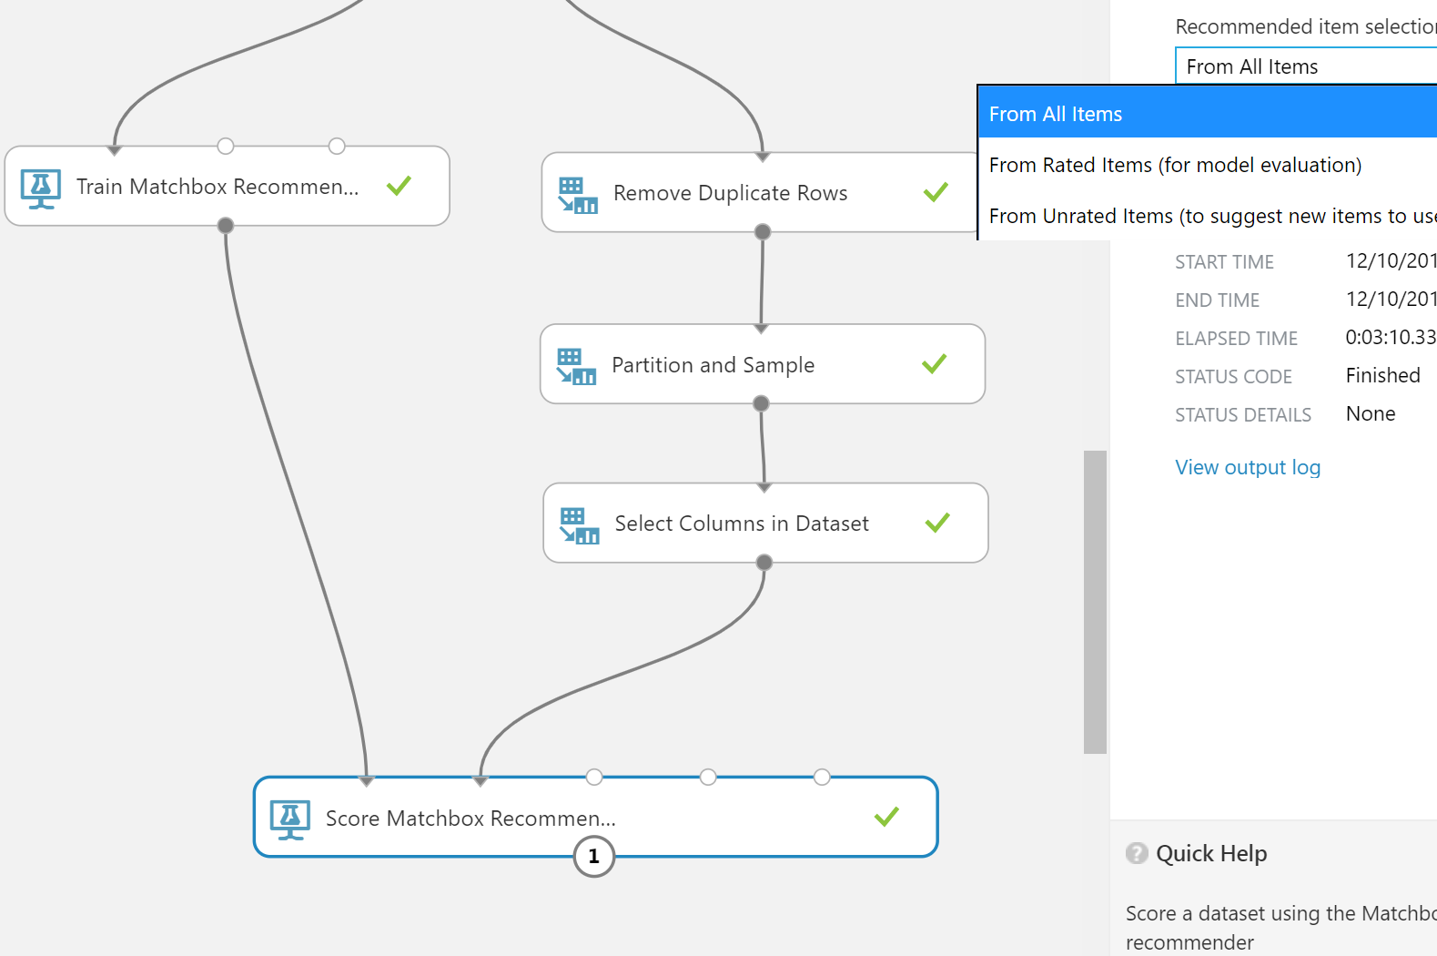
SCORE MODEL
Insert “Score Matchbox Recommender”
To see the top 5 items, select “From All Items” from the “Recommended Item Slection”
Many tweaks can be set here if needed such as the kind of results we want or what to “predict”
More info: Documentation

Slide 16
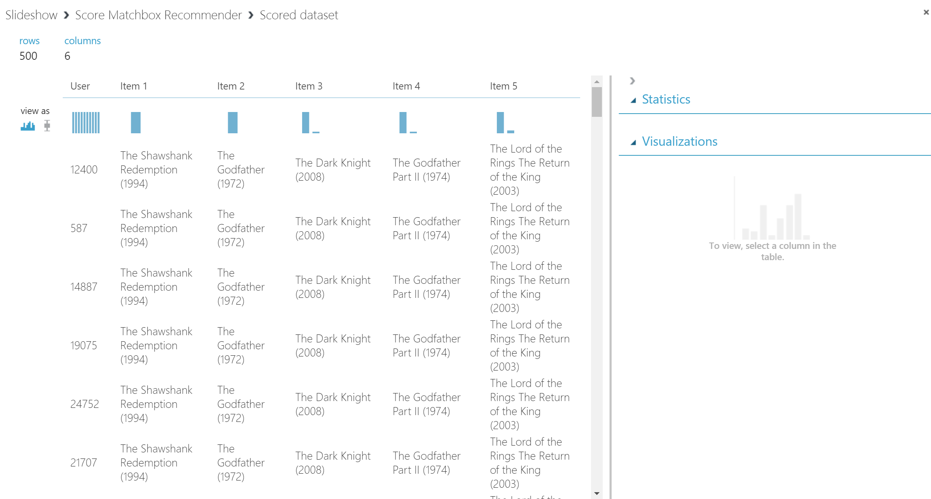
RESULTS
Visualize or use “convert to CSV” tool to download csv file.

Slide 17
CLASSIFICATION
Using Two Class Logistic Regression
& Bayes Point Machine

Slide 18
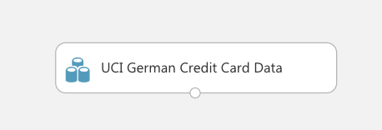
DATASET TWO-CLASS LOGISTIC REGRESSION
UCI German Credit Card Data

Slide 19
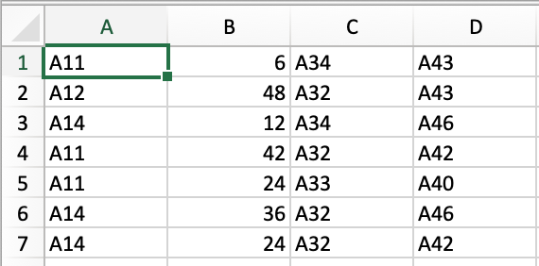
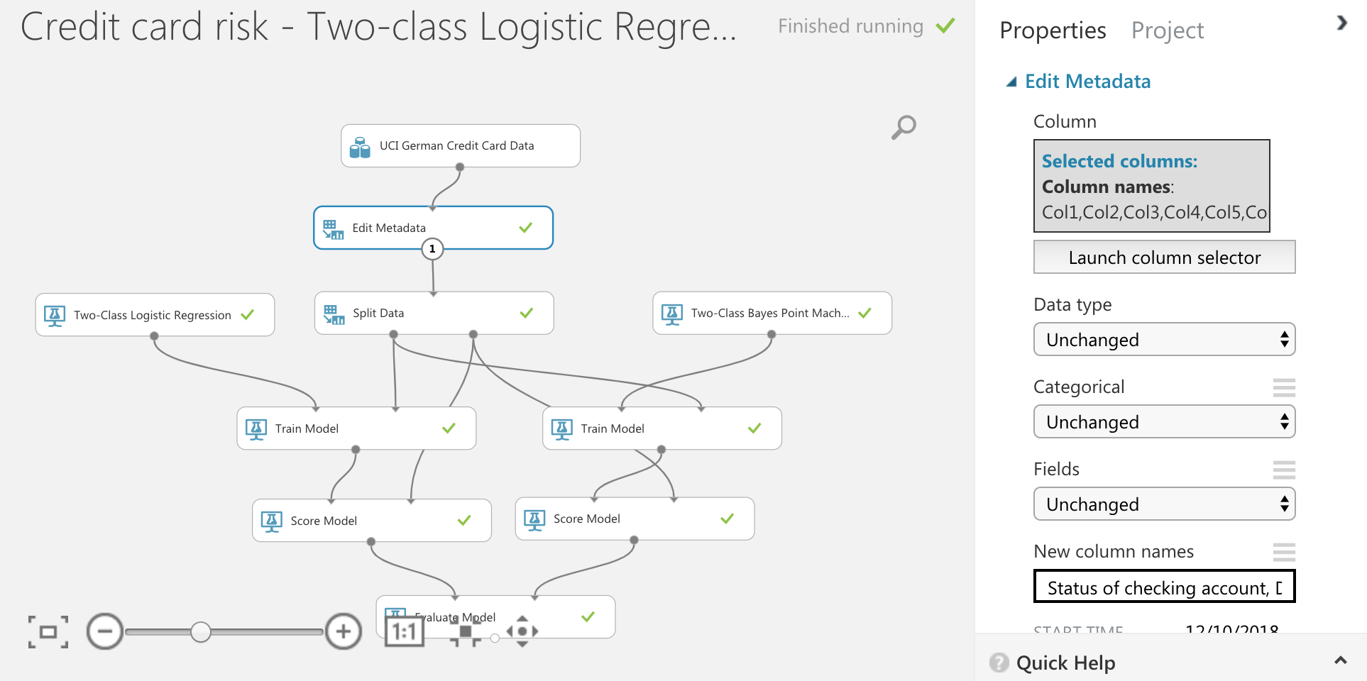
DATA PREPARATION
Edit Metadata
Renaming the columns
New column names
Insert “Edit Metadata”
Launch column selector and choose all
Write new column names into “New column names”

Slide 20
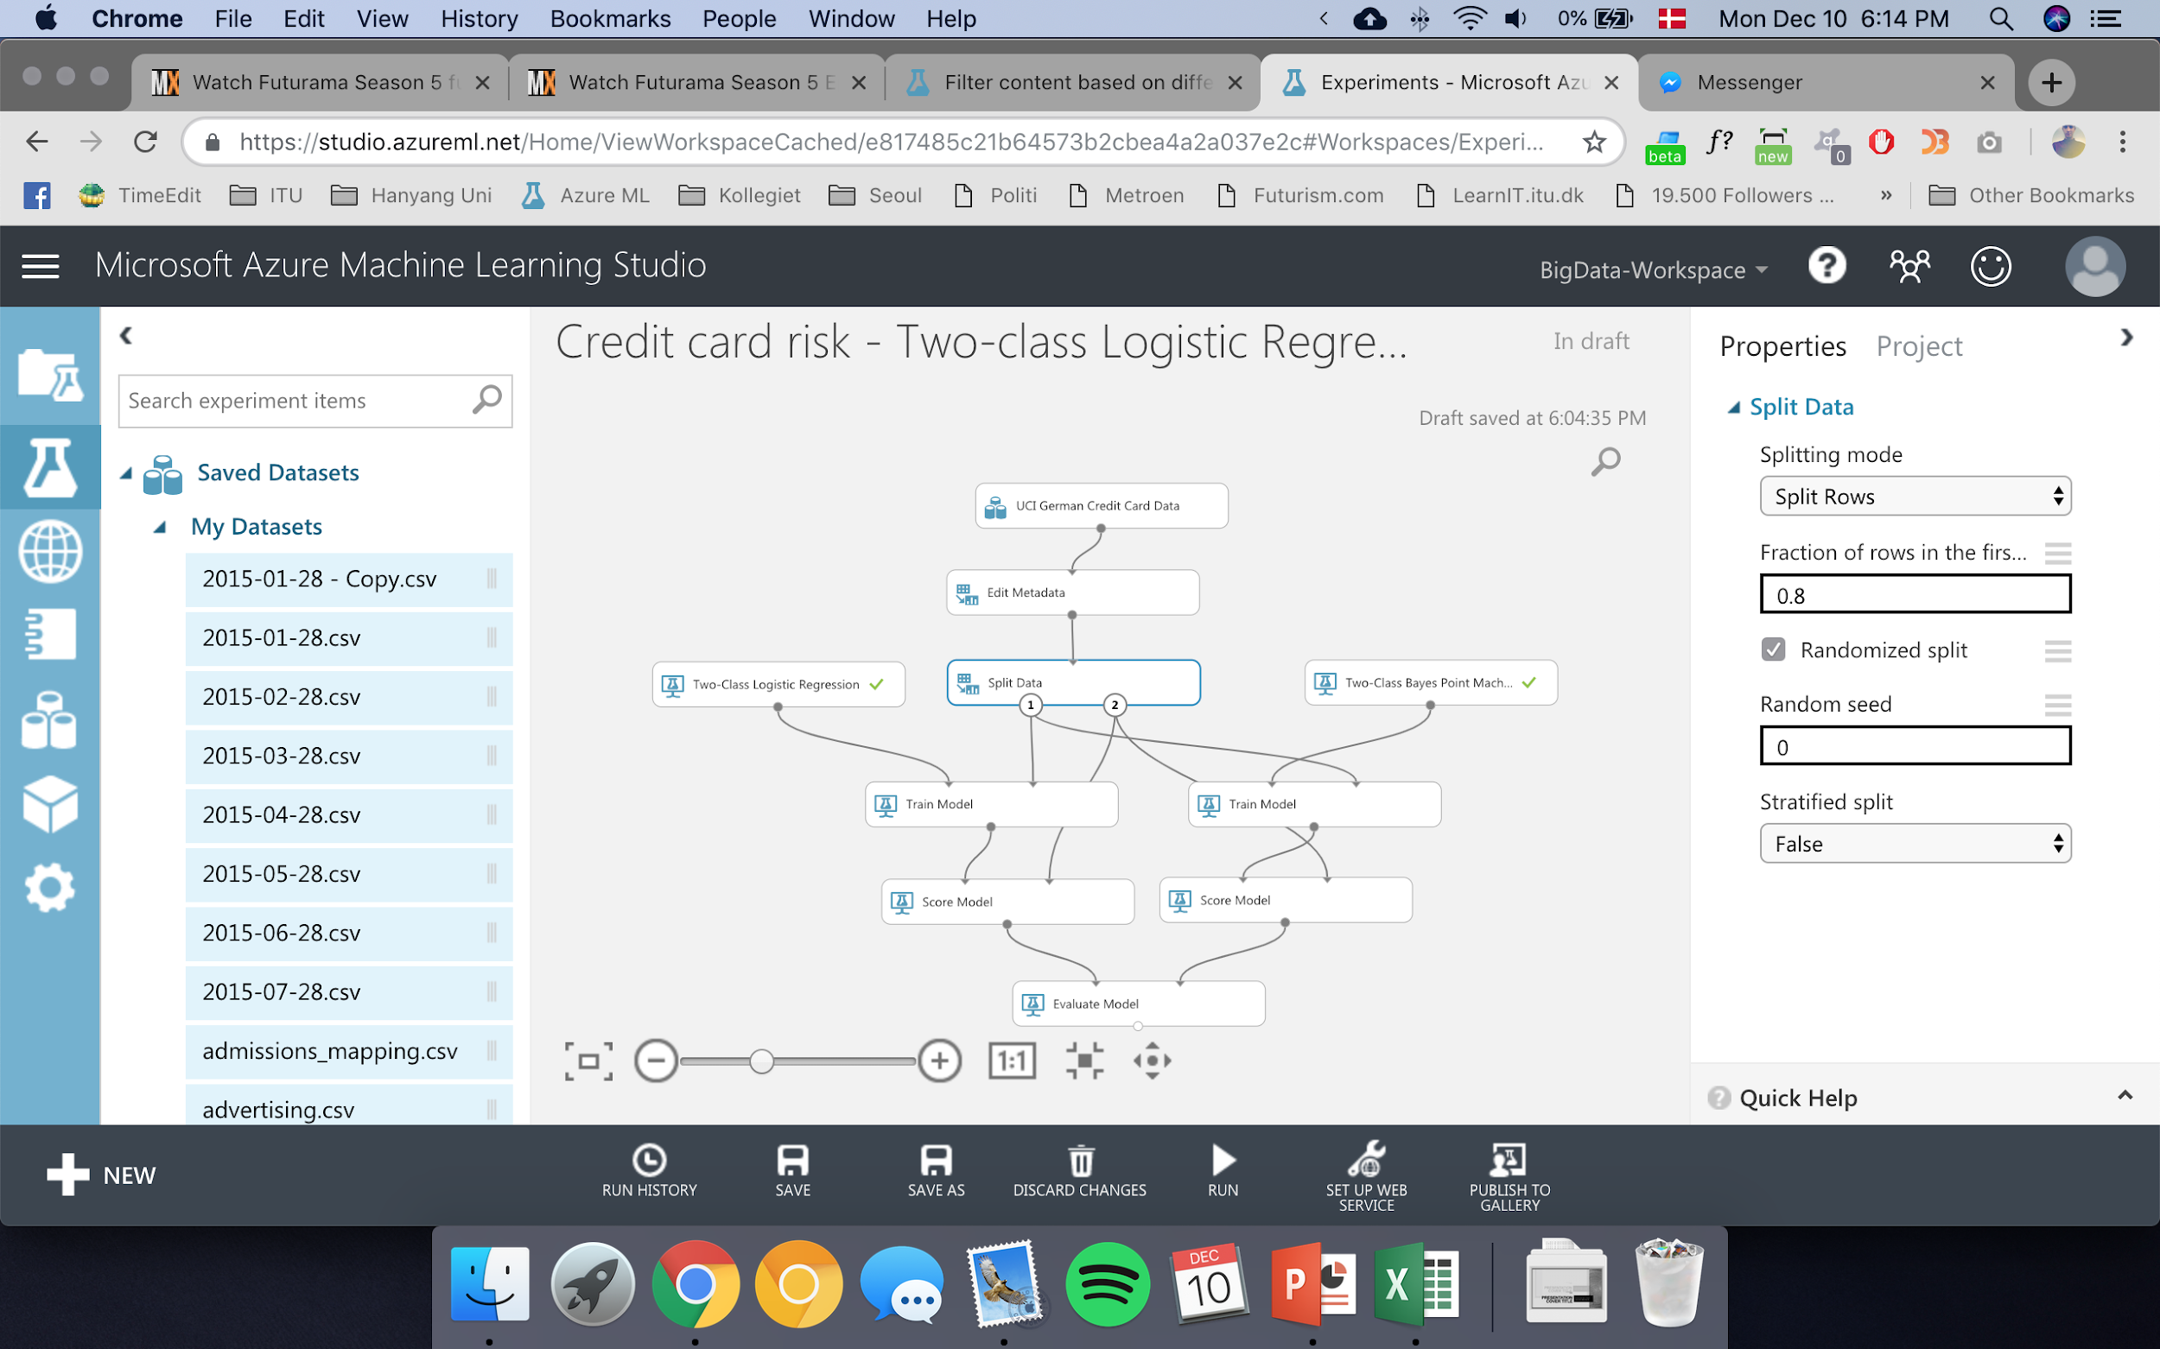
SPLITTING DATA
Insert “Split Data”
Set splitting mode to “Split Rows”
“Fraction of rows in the first dataset” is the amount of rows used for training. We set this to 0.8
Left port (1): Training Data Right port (2): Test Data

Slide 21
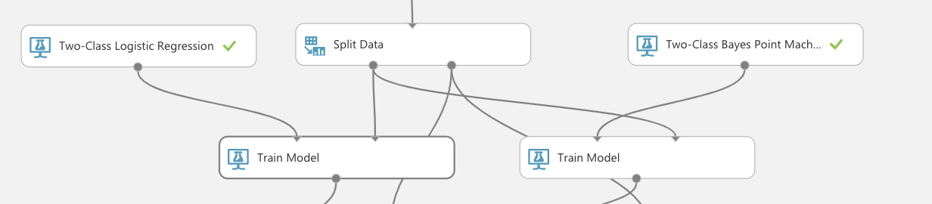
TRAIN MODEL
Insert “Two-Class Logistic Regression” and “Two-Class Bayes Point Machine”
Many tweaks can be set here if needed such as the number of iterations but not needed.
Port 1 for algorithm, Port 2 for 80% of dataset.

Slide 22
SCORE MODEL
Insert “Score Model” for both models and connect
Port 1 for trained model, Port 2 for untrained (test) dataset.

Slide 23
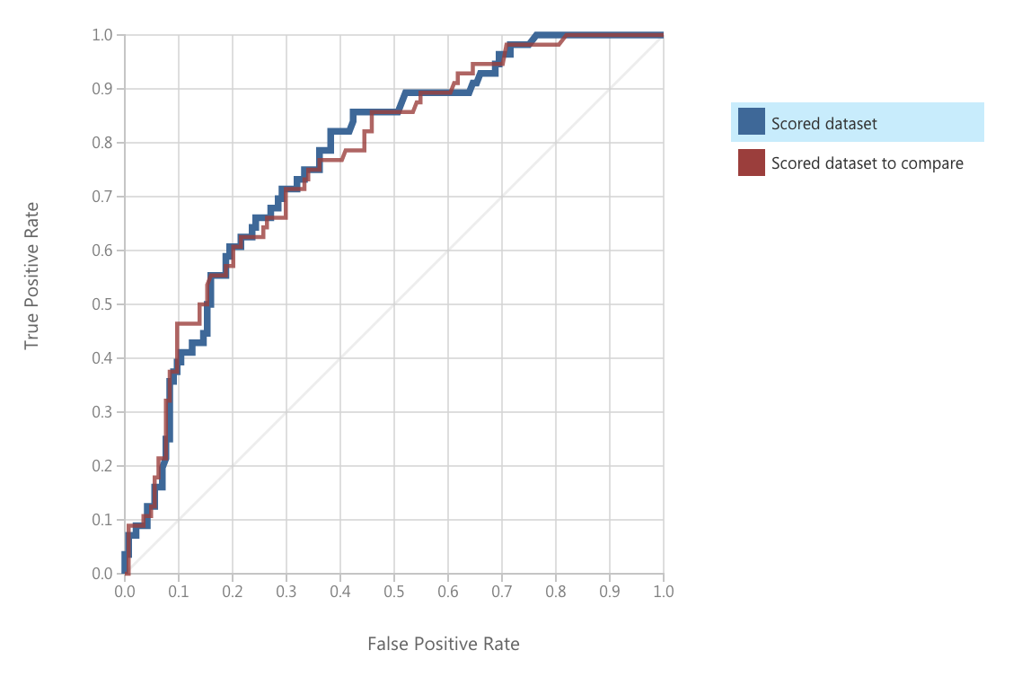
EVALUATE MODEL
Insert “Evaluate Model” for both models and connect
Port 1 for “Two-class Logistic Regression”, Port 2 for “Two-Class Bayes Point Machine”
Does not matter which port for which algorithm.

Slide 24
THANK YOU
Azure Machine Learning Studio

